Slide 1
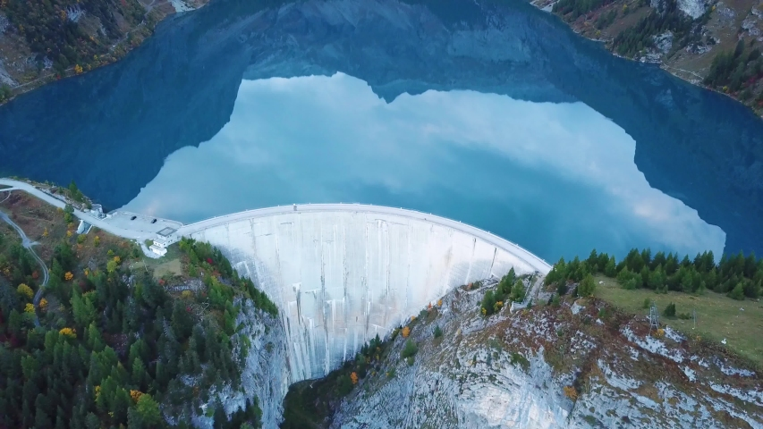
Energy Geographies Research Group Annual General Meeting 2024
Chair: Catherine Butler
Treasurer: Ami Crowther
Secretary: Helena Hastie

Slide 2
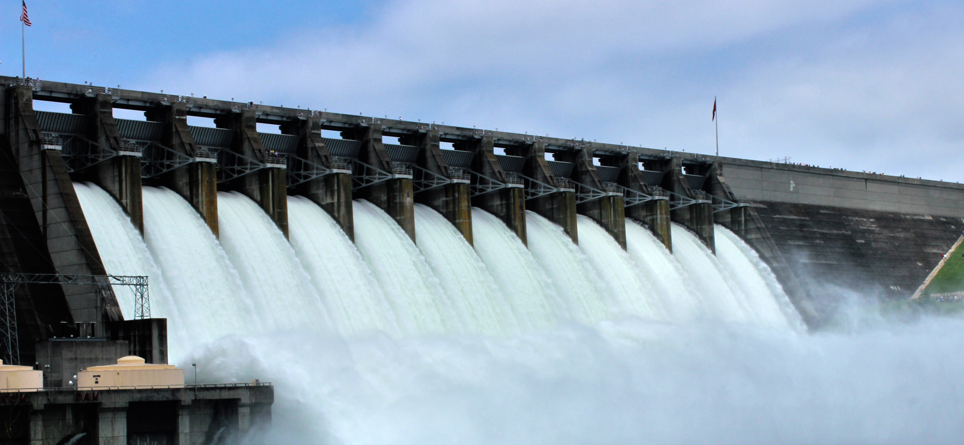
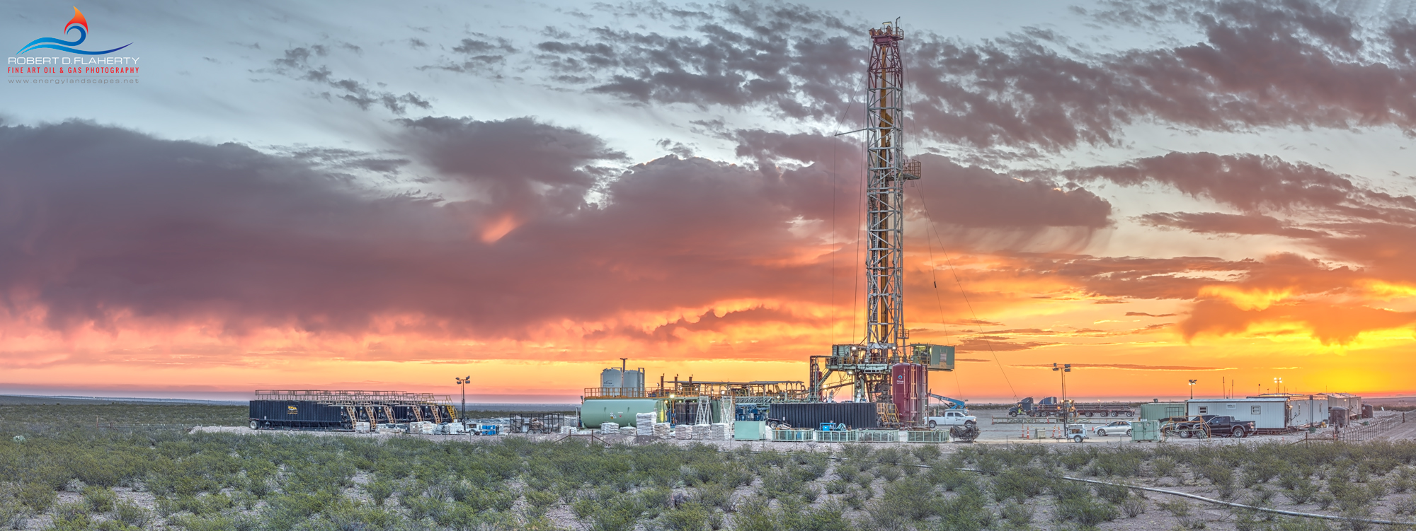
Energy Geographies Research Group Find us: LinkedIn Energy Geographies Group; @EnergyGeography on X; Jiscmail ENGRG, website: energygeographies.org
Notes:
Research interests of the group – broad encompassing all aspects of energy production consumption and transmission and spanning a wide range of topics from governance, to socio-technical transitions or transformations, through to intersections between energy and wider issues of gender, poverty, and decolonization – all topics addressed in our annual webinar series.
Find us on: LinkedIn, X and Jiscmail using the slide links – and visit our website! Please share with others you think will be interested in the group’s work.

Slide 3
Update on membership
90 Royal Geographical Society members
591 followers on X
556 Subscribers to our mailing list
Notes:
Joining the energy geographies group is free and anyone can get involved by simply joining our mailing list, following us on X, and checking out our excellent website developed by Peter forman – the previous chair – where you can find lots more information on ways to get involved in the work of the group.
We currently have 90 members signed to the energy geographies research group from within the RGS membership – for these group members we are allocated money from the RGS each year to spend on the groups activities so should you be a fully signed member of the RGS we would very much appreciate you becoming an official member or the research group as this gives income to the research group for us to spend on energy related activities! You can do this by completing a short form and emailing that into the RGS – details available via email and our webpages.
We have 591 followers on our main social media platform X (formerly twitter) – we have taken the decision to focus more energy on LinkedIn and reduce our content on X (though we will still be on there if you are looking for posts and info check LinkedIn from here on).
And we have 556 subscribers to our jiscmail mailing list – which we use to circulate news from the group and occasional opportunities and events that we think will be of interest to list members.

Slide 4
EnGRG Finances Update
Balance end of 23/24: £1803.61
Balance end of 24/25: £2665.10
Income:
RGS funding - £273
Book royalties - £1313
Expenditure:
Website - £279
PGR awards - £102
UG awards - £125
BSA/EnGRG conference - £218
There’s money available to do things, any ideas or suggestions welcome!

Slide 5
Update on activities in 2023/24

Slide 6
2024 Webinar Series - Decolonising Energy Geographies
Summer 2024 – talks from Ankit Kumar (University of Sheffield), Cymene Howe (Rice University), Idalina Baptista (University of Oxford), Will Monteith (Queen Mary University London)
Available to watch back on our webpages!

Slide 7
Joint event with the British Sociological Association Climate Change Study Group
The Politics of Emotion in the New Zero Transition
Organisers: Pancho Lewis (BSA) and Kurtulus Deger (ENGRG) – Ami Crowther and Helena Hastie represented the group on the day
Write up on the event available on the ENGRG website ‘Latest’ section

Slide 8
Communications from ENGRG
Website
Newsletter
Social media (X, LinkedIn)
Notes:
We have launched our newsletter this year which goes out once a quarter to the email list and contains info and updates on the group’s activities along with wider features of interest to group members such as recent publications.
We have taken the decision to focus more energy on LinkedIn and reduce our content on X (though we will still be on there if you are looking for posts and info check LinkedIn from here on).

Slide 9
Awards and Prizes
Post graduate Researcher Paper Competition
8 submissions from UK/Europe, North America and Australia. Winners:
Impact and Engagement - Sarah Lerman-Sinkoff, “Become a Gas Leak Detective!”
Conceptual contribution – Pancho Lewis, Re-attaching to coal in a Climate Emergency: The case of the Whitehaven mine
Highly commended: Rachel Bray, The co-benefits and risks of smart local energy systems: a systematic review
Undergraduate Dissertation Prize
We had 6 nominations for the undergraduate dissertation prize this year, with students from Durham, Nottingham, Newcastle, Leeds, Cambridge and Bristol.
These are currently being marked, and are due to be awarded by the end of September.
Notes:
The PGR Award this year:
There were 8 submissions (from UK/Europe, North America and Australia!) and the winners were:
Impact and Engagement - Sarah Lerman-Sinkoff, “Become a Gas Leak Detective!” Evaluating a Multigenerational Citizen Science Program for Connecting Distribution Pipeline to Energy Justice
Conceptual contribution – Pancho Lewis, Re-attaching to coal in a Climate Emergency: The case of the Whitehaven mine
Plus there was a highly commended (but not winning) submission:
Research Design and Methods – Rachel Bray, The co-benefits and risks of smart local energy systems: a systematic review
For the UG Dissertation Prize this year:
This was promoted by the RGS in addition to our own promotion.
We had 6 nominations for the undergraduate dissertation prize this year, with students from Durham, Nottingham, Newcastle, Leeds, Cambridge and Bristol.
These are currently being marked and are due to be awarded by the end of September.

Slide 10
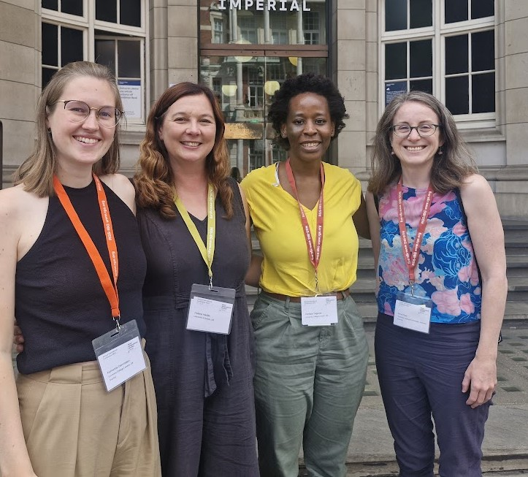
RGS Annual Conference 2024
The group sponsored 9 sessions at the RGS, including two sessions on electricity access in sub-Saharan Africa, led by Helena, Katharina and Penlope
We then held a research group lunch, which was an opportunity for an informal catch up and to meet new members
Notes:
We had another great year at the RGS annual conference with 9 sessions sponsored by us and lots of great engagement with energy geographical topics and interests across the conference.

Slide 11
Future Activities, Plans & Proposals
Open discussion on next years activities, plans and proposals

Slide 12
Activities for 2024/25 – discussion points…
Sub-committee meeting of the RGS research groups and our annual reporting – slides from today available online next week
Annual Conference 2025 – conference 27th-29th August 2025; calls out November/December. Theme is Creativity!
Thoughts about sessions, proposals, Engrg sponsorship or additional support!
PGR Midterm Conference – highlight and encourage submissions/sessions on energy geographies
Notes:
Update on upcoming events
The theme for the RGS annual conference 2025 is Creativity and it will be held at University of Birmingham – we are looking forward to developing some really interesting sessions and contributions for that conference so watch out for the calls in November!

Slide 13
Activities for 2024/25 – discussion points…
Awards and Prizes – development of current prizes? Other possible prizes we could develop?
PGR event – Nivedita Singh (PGR rep) proposal in development “Pathways to Sustainable Futures: Just Energy Transitions and Decarbonisation”
Webinar Series – theme for next year? Timing?
Other ideas for activities – EDI related? Website development updates? Social Media presence?
Notes:
We will run our PGR and UG prizes again this year with newly appointed coordinators – at the AGM we discussed other possible prizes we could develop and have some great ideas so watch this space for more on that!
We are currently planning an event led by our PGR reps for later this year.
We will run our webinar series again this year in the Spring and are currently thinking about the theme so please feel free to send in your suggestions and ideas.
We also discussed other activities and will be developing them throughout the year – again we welcome contributions from the wider group.

Slide 14
Hustings
Update on the committee and introducing our nominees for new committee members
Notes:
We held our elections for new committee members to replace outgoing members and fill roles with 5 contestations nominations – 4 to specific roles and 1 general committee member. Their info and details can be found on the following slides. We are excited to welcome them all on to the committee and look forward to working with them all this coming year!
If you would like to become a committee member and get more actively involved in the group we hold elections each year at the AGM but welcome interest all year round!

Slide 15
Update on committee membership
Committee membership – 25 members on our committee in 2024 with roles across most areas identified by the RGS
4 committee members have stepped down this year – Secretary Rachel Macrorie, Leonard Schliesser PGR rep, two general committee members Laure-Anne Pluhmans and Elspeth Opperman. 1 has stepped back from their official role as Awards officer – Jess Britton – to become a general committee member
Recruited for Secretary role, Awards Officer/Coordinator role, PGR role, and an ECR role, also welcoming a new general committee member and opening the invitation for others
Notes:
Current membership – 21 remaining members – thanks to those leaving the committee
Welcome to those joining us –
We have recruited for: Secretary; Awards Coordinator; PGR rep; ECR rep; and General Committee Members

Slide 16
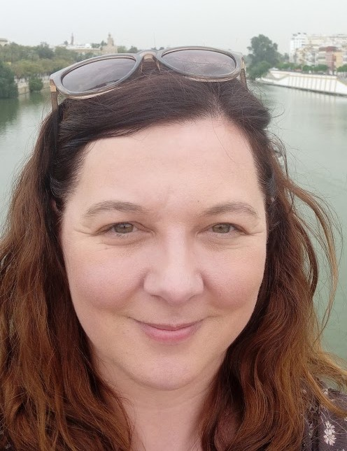
Nominee for Secretary
Helena Hastie
Associate Lecturer in Human Geography
University of Exeter
I have just completed a PhD looking at energy transitions and electricity access in Eswatini (formerly Swaziland). I’ve been a committee member of the EnGRG for the past two years and served as awards officer for that time. My research interests are on household access to electricity, the transition to renewable energy, and the reduction of poverty in sub-Saharan Africa. As Secretary I look forward to continuing to contribute to the committee and further develop the reach and impact of the group’s activities and energy geographies more broadly.

Slide 17
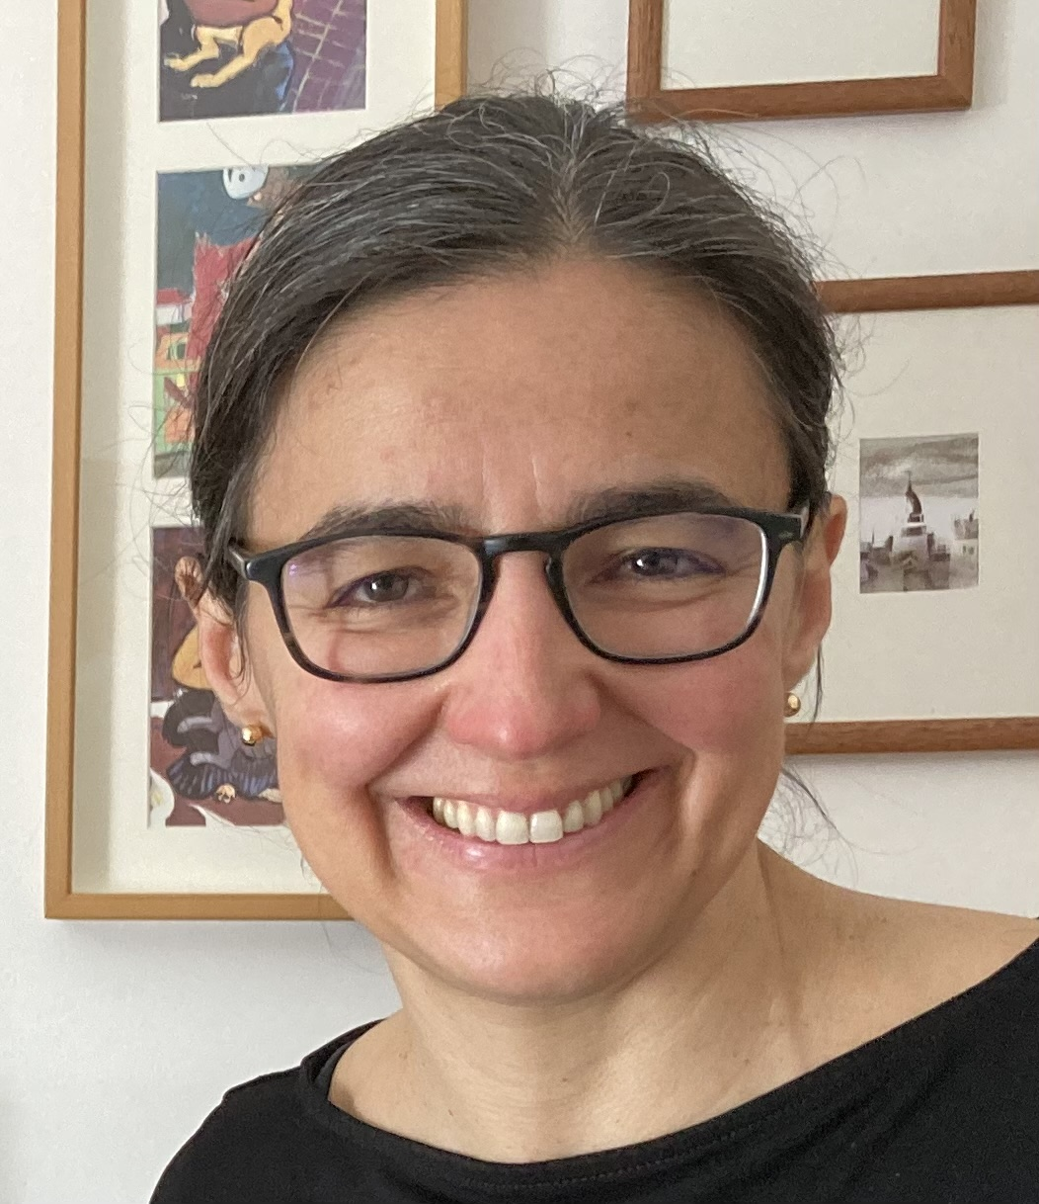
Nominee for Awards Coordinator
Idalina Baptista
University of Oxford
I am an Associate Professor at the University of Oxford with research interests in colonial and post-colonial geographies of urban energy infrastructure and urbanisation. As an Awards Officer, I look forward to working with the EnGRG’s committee and group members to continue deepening our understanding of the geographical dimensions of energy issues through research, teaching, and activism. The EnGRG’s awards are excellent opportunities to celebrate outstanding work by students who are the next generation of professionals, policymakers, educators, researchers, and/or activists driving forward the group’s interests and agenda.

Slide 18
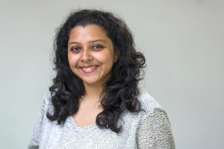
Nominee for Post Graduate Rep
Nayani Ghoshal
PhD Candidate
University of Exeter
I started my PHD with a scholarship from UKRI EPSRC within the Environment and Sustainability Research Group based at the Department of Human Geography, the University of Exeter. In my research, titled “Net Zero Energy Transition in Rural Landscapes: A Study into the Interface between Technology, Livelihood, and Climate”, I aim to investigate the energy justice issues related to net-zero energy transition and its impact on the everyday life and livelihood of the people who are directly and indirectly impacted both positively and negatively. As PGR rep I hope to support the development of new activities for the post graduate community.

Slide 19
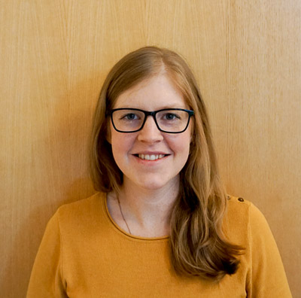
Nominee for Early Career Researcher Rep
Llinos Brown
Research Fellow
University of Leeds
I completed my PhD in 2017. After a little break, I returned to academia in 2020 as a researcher at The University of Leeds and have recently come back from maternity leave. I am a transport/energy geographer working on two projects – one funded by the EDRC (Energy Demand Research Centre) titled ‘Community Groups as Agents for Change’ looking at the activities of community groups and the impacts they have on energy demand, and a UKERC/CREDS/ClimateXChange funded project ‘TRANSAS’, which looks at how travel and lifestyles have changed since the pandemic. Previous committee roles have been as Chair of the RGS Postgraduate Forum (2014-2015) and Treasurer (2013-2014). As ECR rep I hope to contribute to developing the activities and resources targeted at early career researchers.

Slide 20
Call for General Committee Members
General committee members contribute to the running of the group providing support for key activities such as the awards and annual conference and help promote the group within the wider energy geographies community. Two general committee members have stepped down – encouraging interest in becoming involved in the group in this way.
Nominee to the committee as a general committee member - Pancho Lewis, (PhD researcher) Lancaster University

Slide 21
AOB?
Any other questions, comments, reflections?
Slides added to the website soon to serve as our annual report to members
Remember to check out the webinar presentations, report on the BSA/EnGRG joint event, and all the other resources available there for research and teaching.
Thanks to all committee members for their work this year and continuing to make the energy geographies research group the vibrant active space that it is!

